Slide 1
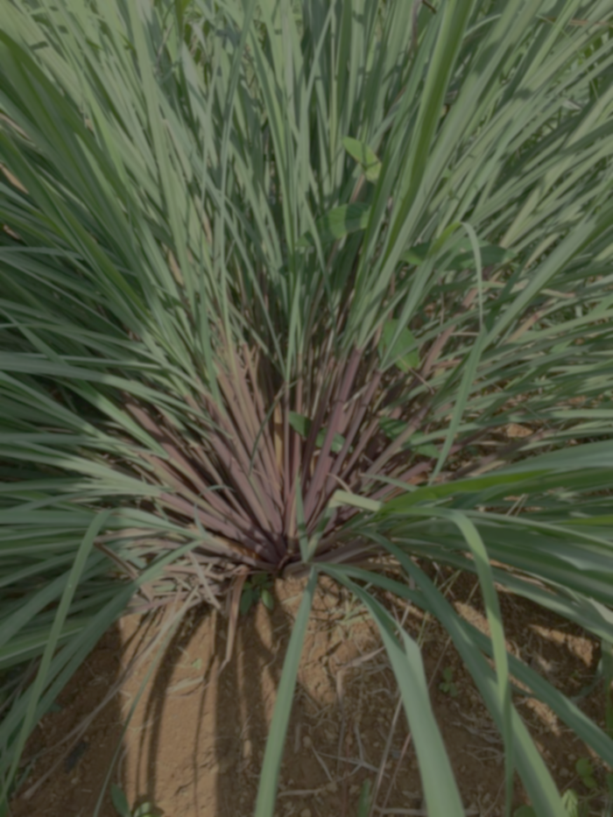
Secondary Metabolites and Antioxidants Activity from Citronella Grass Extract (Cymbopogon nardus L.) Rofiatun Solekha ^{1,2, b)}, PAI Setiyowati ^{2, b)}, Ni Nyoman Tripuspaningsih ^{2, b)}, Hery Purnobasuki ^{2, a)} ¹Department of Biology, Faculty of Sciences Technology and Education, Universitas Muhammadiyah Lamongan, Jawa Timur, Indonesia. ² Department of Doctorate in Mathematics and Sciences, Faculty of Sciences and Technology Universitas Airlangga, Surabaya, Indonesia.
MIPAnet and MDSM Annual Meeting and The 3rd International Conference On Natural Sciences, Mathematics, Applications, Research, and Technology ( ICON SMART 2022 )

Slide 2
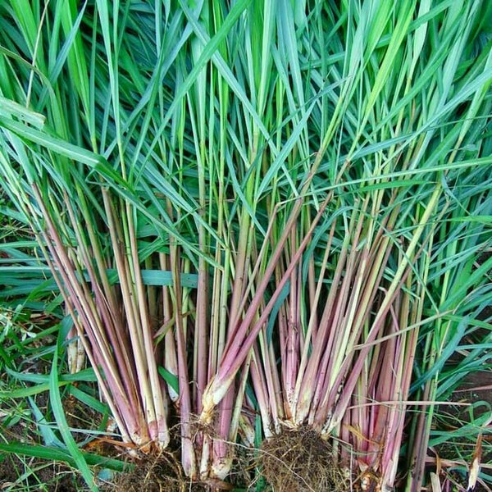
ABSTRACT
Citronella is a rhizome plant that has been widely used and has proven its efficacy. People use plant organs in lemongrass for use in several benefits according to their needs. With this we know how the secondary metabolites of citronella include stems, leaves and roots as well as the antioxidant content of citronella grass compared to ordinary lemongrass and reeds. The method used in screening secondary metabolites is GCMS (Gas Chromatography and Mass Spectroscopy) with methanol solvent, then the compounds can be identified through the existing library. The method used to analyze antioxidants using DPPH (2,2-diphenyl-1-picrylhydrazyl). The secondary metabolites produced in Cymbopogon nardus L. stems are elemol, 2-nephthalenemethanol, and ethyl oleate; in the root are elemol, 1-Dodecamine, N,N-dimethyl-(CAS), 1-Tetradecanamine, N,N-dimethyl (CAS); and in the leaves there are elemol, 9,2-octadecadienoic acid, methyl ester, (E,E)-(CAS), 1-dodecanamine, N,N-dimethy;l-(CAS). The highest antioxidant activity found in Cymbopogon nardus 79.5 g/ml followed by Cimbopogon citrasus 58.4 g/ml and the third in Imperata cylindrica 43.7 g/ml. It can be said that the content of secondary metabolites in catang, roots and leaves both have elemol and antioxidant activity of citronella is higher than ordinary lemongrass and Imperata cylindrica.
Keywords: Antioxidants; Cymbopogon_nardus, Flavonoids, Secondary_metabolites.

Slide 3
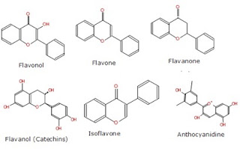
INTRODUCTION
Cymbopogon nardus
secondary metabolites that can increase theo immune system in the body because they contain chemical compounds that have biological activities
an approach method that can use GCMS {2}
Flavonoids have been shown to have a very strong biological antioxidant effect
Flavonoids are one of the secondary metabolites found in plants
Research on Lemograss (Cymbopogon nardus) was carried out focusing on phytochemical screening, antioxidant activity and flavonoid content of ethanol extract so that information can be obtained which can serve as basic data in an effort to utilize Lemograss (Cimbopogon nardus) as a rhizome plant.

Slide 4
MATHERIALS AND METHODS
Matherials
The materials that is used in this study were stirring road, blender, funnel, Erlenmeyer flask, watch glass, beker (Pyrex®), measuring flask, watch glass, beaker (Pyrex®), micro-pipet, oven (memmert®), tube clamp, pH meter, droppet pipette, measuring pipette, UV Vis spechtrofotometer and GCMS. While the materials used were destilled water, ascorbic acid, 1% oxalic acid, 10 % trichloroacetic acid, FeCl₃ 0,1 %, phosphate buffer 0,2 M pH 6.6, etanol 96%, potassium ferrycianide, filter papper, Cimbopogon nardus

Slide 5
Methods
1. Preparation of Sampel
The plants materials were collected and cleaned, dried at room temperature, crushed into powder and stored in an air tight glass container. Fifty g of powdered samples was extracted by reflux using 96% ethanol as the solvent for 2 h and repeated 3 times. The extracts then evaporated using a vacuum rotatory evaporator, and then dried in water bath on 50°C.
2. Secondary Metabolites
The leaves, stems and roots that are ttacted by disease are10 cm long, cut into small pieces and then baked at 40ºC. after drying, it was mashed using a blender and macerated using 70% ethanol in a ratio of 1:6 for 72 hours. The maceration, the extract was evaporated at 60ºC until thickened. The extract result were analyzed using the GCMS method and presented in the form of lolecular weight screening based on the library.

Slide 6
3. Level Flavonoid Total
Standard solution of quercetin in concentration 30, 40, 50, 60, 70, 80, 90, 100 µg/ml were prepared in 96% ethanol. 50 µl of extracts (1 mg/ml) or standard solution was added to 10 µl of 10% the aluminium chloride solution and followed by 150 µl of 96% ethanol. 10 µl of 1 M sodium acetate was added to the mixture in a 96 well plate. 96% ethanol was used as reagent blank. All reagents were mixed and incubated for 40 min at room temperature protected from light. The absorbance was measured at 415 nm with a microplate reader (Versamax Microplate Reader, USA). Total flavonoid contents were expressed as mg Quercetin Equivalents (QE)/g of plant extract.
4. Antioxidant Activity
The DPPH assay measured hydrogen atom (or one electron) donating activity and hence provided an evaluation of antioxidant activity due to free radical scavenging. 2,2-Dipheny lpicrylhydrazyl radical (DPPH) a purple-colored stable free radical is reduced into the yellow colored diphenylpicryl hydrazine. Thirty minute after spraying active compounds appear as yellow spots against purple background. In a second time, spectrophotometric assay was 131 carried out by the following method: 30 µl of a methanolic added to 3 ml of a 0.004% MeOH solution of DPPH. Absorbance at 517 nm was determined (Perkin–Elmer-Lambda 11 spectrophotometer) after 30 min, and the percentage of activity was calculated [10].

Slide 7
RESULT AND DISCUSSION
Secondary metabolites in stem is elemol 23,92%, 2-nephthalenemethanol 10,63%, and etil oleate 7,70%.
Picture 1. GCMS solution of Stems

Slide 8
From picture 2, in root is elemol 20,87%, 1-Dodecamine, N,N-dimethyl-(CAS) 1-Tetradecanamine 12,68%, N,N-dimethyl (CAS) 9,20%.
Picture 2. GCMS solution of roots

Slide 9
and in leaf is elemol, 9,2-octadecadienoic acid 21,23%, methyl ester, (E,E)-(CAS) 12,4% and 1-dodecanamine, N,N-dimethy;l-(CAS) 8,53%, .
Picture 3. GCMS solution of leaves

Slide 10
All there were analyzed using GCMS, the result is there all three contains elemol. elemol as a major oil constituent in both of the Citronella grass species.Elemol, a major constituent of the essential oil of Osage orange (Moraceae), have been shown by Paluch et al. (2009) to repell the yellow fever mosquito, Aedes aegypti (L.)
In the three organs alanyzed, in highest secondary metabolite in each organ was elemol. The elemol content in the stems has the highest content compared to the leaves and roots. This shows that the efficacy of stem if used will be more efficacious when compared to the leaves and roots.
The essential oil inhibited the growth of A. niger at higher concentration (400 mg/L) (Billerbeck, 2001), whereas it showed inhibition at much lower concentration (4 mg/ml) against P. putida (Oussalah,2006).
Secondary metabolites from its biological potential, it can be used as a bioadditive (Rizal et al., 2017) and its waste can be used to produce biogas, especially methane (Suali et al., 2019). It could be used as an alternative for future mouthwash’s formulations (Cunha et al., 2020)

Slide 11
Peak# | R.Time | Area | Area% | Height | Name
1 | 6.239 | 12839909 | 0.28 | 1535710 | Benzyl chloride
2 | 7.658 | 12376216 | 0.27 | 1802999 | Phenol, 2-methoxy- (CAS)
3 | 11.668 | 125111700 | 2.74 | 6418871 | 2,3-DIHYDRO-BENZOFURAN
4 | 13.422 | 51648715 | 1.13 | 6874266 | 2-Methoxy-4-vinylphenol
5 | 14.391 | 23351728 | 0.51 | 2674771 | Phenol, 2,6-dimethoxy- (CAS)
6 | 17.070 | 16920620 | 0.37 | 1871655 | Phenol, 2-methoxy-4-(1-propenyl)-, (E)- (CAS)
7 | 18.150 | 233707571 | 5.13 | 19829723 | Methanamine, N,N-dimethyl- (CAS)
8 | 18.480 | 13353465 | 0.29 | 1870101 | NAPHTHALENE, 1,2,3,4,4A,5,6,8A-OCTAHYDRO-7-METHYL-4-METHYLENE-1-(1-METHYLE
9 | 18.753 | 60165972 | 1.32 | 7025254 | Elemol
10 | 18.971 | 14150947 | 0.31 | 1077792 | spathulanol
11 | 19.842 | 1090616460 | 23.92 | 63453411 | Elemol
12 | 20.079 | 42195436 | 0.93 | 7238649 | 3',5'-Dimethoxyacetophenone
13 | 20.266 | 58979527 | 1.29 | 11540858 | endo-1-bourbonanol
14 | 20.906 | 29524267 | 0.65 | 4220638 | Phenol, 2,6-dimethoxy-4-(2-propenyl)- (CAS)
15 | 21.580 | 100578054 | 2.21 | 13986433 | 10-epi-.gamma.-eudesmol
16 | 21.807 | 75532999 | 1.66 | 6591457 | Torreyol
17 | 22.289 | 484747402 | 10.63 | 43586224 | 2-Naphthalenemethanol, 1,2,3,4,4a,5,6,8a-octahydro-.alpha.,.alpha.,4a,8-tetramethyl-, [2R-(2.alpha.,4a.
18 | 22.937 | 142614810 | 3.13 | 14774030 | 1-Hexadecanaminium, N,N,N-trimethyl-, bromide
19 | 23.261 | 45190435 | 0.99 | 5450550 | Phenol, 2,6-dimethoxy-4-(2-propenyl)- (CAS)
20 | 24.089 | 30274224 | 0.66 | 5233279 | 1-Cyclohexanone, 2-methyl-2-(3-methyl-2-oxobutyl)
21 | 24.593 | 24019709 | 0.53 | 1693753 | Phenol, 4-(3-hydroxy-1-propenyl)-2-methoxy- (CAS)
22 | 24.855 | 25474673 | 0.56 | 3979515 | Heptadecanoic acid, ethyl ester (CAS)
23 | 25.009 | 34826529 | 0.76 | 4036607 | Rosifoliol
24 | 26.210 | 507687148 | 11.13 | 27085934 | Rosifoliol
25 | 27.002 | 56246996 | 1.23 | 3660930 | 1-Naphthalenamine, 4-bromo- (CAS)
26 | 27.236 | 61817965 | 1.36 | 5053270 | 6-Isopropenyl-4,8a-dimethyl-1,2,3,5,6,7,8,8a-octahydro-naphthalen-2-ol
27 | 27.717 | 125429369 | 2.75 | 13659133 | Cyclopropanebutanoic acid, 2-[[2-[[2-[(2-pentylcyclopropyl)methyl]cyclopropyl]methyl]cyclopropyl]m
28 | 28.655 | 13646759 | 0.30 | 1071041 | 2,4,7,14-Tetramethyl-4-vinyl-tricyclo[5.4.3.0(1,8)]tetradecan-6-ol
29 | 29.144 | 170442054 | 3.74 | 26518320 | Hexadecanoic acid, ethyl ester (CAS)
30 | 29.743 | 95243121 | 2.09 | 4346944 | LONGIFOLENALDEHYDE
31 | 30.264 | 21218082 | 0.47 | 1471896 | 4-(2,6,6-Trimethyl-cyclohex-1-enyl)-butyric acid
32 | 30.519 | 32876405 | 0.72 | 2984750 | 2-METHYL-5-(2',6',6'-TRIMETHYL-CYCLOHEX-1'-EN-1'-YL)-PENTAN-2,3-DIOL
33 | 31.251 | 141733549 | 3.11 | 11026770 | 2H-Benzocyclohepten-2-one, decahydro-9a-methyl-, trans- (CAS)
34 | 31.560 | 131578848 | 2.89 | 20725591 | 1-Allyl-3-methylcyclohex-2-enol
35 | 32.543 | 351145928 | 7.70 | 30915424 | Ethyl Oleate
36 | 32.912 | 28896799 | 0.63 | 6017358 | Heptadecanoic acid, ethyl ester (CAS)
37 | 35.272 | 46824901 | 1.03 | 10860091 | 1-Phenyl-2-propanone
38 | 38.596 | 8047403 | 0.18 | 1163438 | Hexadecanoic acid, 2-hydroxy-1-(hydroxymethyl)ethyl ester (CAS)
39 | 38.990 | 9384300 | 0.21 | 1536672 | N-(2,6-DIMETHYL-PHENYL)-N-(2-MORPHOLIN-4-YL-2-PHENYL-ACETYL)-2-PHENYL-ACET
40 | 39.505 | 9636334 | 0.21 | 2198886 | Dodecanoic acid, phenylmethyl ester (CAS)
 |  | 4560057329 | 100.00 | 407062994

Slide 12
Table 2. Level flavonoids total of Cymbopogon nardus
 | Variabel | Flavonoid content (g QE/100 g) | Flavonoid levels (%)
Cymbopogon nardus (Citronella grass) | Root | 0.0115^{cd} | 1.15^{cd}
 | Stem | 0.0400ª | 4ª
 | Leaf | 0.0081^{d} | 0.8^{d}
Cymbopogon citratus (Lemongrass) | Root | 0.0011^{ef} | 0.11^{ef}
 | Stem | 0.2840^{b} | 2.84^{b}
 | Leaf | 0.0218^{bc} | 2.18^{bc}
Imperata cylindrica (Reed) | Root | 0.0021e | 0.21e
 | Stem | 0.0065de | 0.65de
 | Leaf | 0.0128^{c} | 1.28^{c}
Level flavonoid in citronella grass stems highest than lemongrass and reed is 4% with content 0,0400 g QE/100 g.
Note : The numbers followed by different letters show a significant difference with the DMRT test at 95% confidence level

Slide 13
Variable composition accounts for the promising insecticidal, fungicidal, herbicidal and antioxidant activities shown by falvonoids.
Flavonoids are structurally diverse secondary metabolites in plants, with a multitude of functions. These span from functions in regulating plant development, pigmentation, and UV protection, to an array of roles in defence and signalling between plants and microorganisms (Shirley et al., 2001). Because of their prevalence in the human diet, many flavonoids constitute important components of medicinal plants and are used in the control of inflammation and cancer prevention (Jiang, 2016)
Figure 1. Flavonoid Levels Total

Slide 14
Table 3. Antioxidant Activity (µg/ml)
Organ Varietas | Root | Stem | Leaf
Cymbopogon nardus | 30.8de | 79.5ª | 56.4^{bc}
Cymbopogon citratus | 20.9e | 58.4^{b} | 38.3^{d}
Imperata cylindrica | 11.7^{fg} | 17.3^{f} | 43.7^{c}
Note : The numbers followed by different letters show a significant difference with the DMRT test at 95% confidence level
The antioxidant potential varies with the methods of extraction of the C. nardus essential oil. The essential oil obtained by ohmic-heated hydrodistillation contained high concentration of antioxidant compounds such as citronellal and limonene. It was found that the pure citronellal possessed good antioxidant property with IC50 value of 49 μg/ml (Lu, 2014).

Slide 15
The antioxidant activity of Citronella grass stalks in the highest. As in table 3, lemograss stalks have antioxidant activity of 79.5 µg/ml. the stems of lemograss have the highest antioxidant activity compared to the leaves and roots of lemograss and in varieties of lemograss and impartial species. Then followed by the results of the antioxidant activity of citronella grass stalks, namely 58.4 µg/ml, then the third highest antioxidant activity was in impartial leaves, namely 43.7 µg/ml. from the above results, the results of antioxidant activity correlated directly with flavonoid levels in table 2.

Slide 16
CONCLUSION
In this article, we reviewed studies of citronella essential oil, its traditional importance, chemical composition and some biological activities reported so far. Since ancient times, Citronella is used in Ayurvedic medicine for treatment of redness, irritation, toothaches, rheumatism, digestive problems, headaches, infectious diseases, fatigue and childbirth washes from flavonoids and antioxidants. Recently, it found its use in the paper industry for paper production due to its high cellulose content. It is majorly exploited for its essential oil content. The yield and the chemical composition of C. nardus essential oil also varied with the methods of extraction. Geographical distribution results in variable chemical composition of essential oil. Researches carried out till date on C. nardus essential oil lead to the identification of 30 compounds. The majority of samples contained citronellal, citronellol and geraniol as major components.

